Slide 1




WEB PAGES DESIGN
Additional JavaScript Basics: window Object,
if Statement, Strings, Numbers, and Input
Validation
Lecturer: Dr. Atheer Akram AbdulRazzaq
Lecture 12.
Class 2.
Time: 10:30 - 12:30
Department: Businesses Information Technology (BIT)

Slide 2
Outline
Outline
alert and confirm Methods
if Statement: if by itself
prompt Method
if Statement: else and else if Clauses
Strings
Arithmetic Operators
Math Object Methods
Constraint Validation for Form Controls
Comparison Operators and Logical Operators
Summary

Slide 3
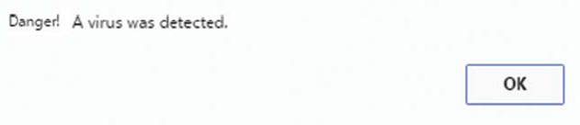
Outline
alert and confirm Methods
Dialog Boxes
The window object’s alert, confirm, and prompt methods generate dialog boxes. A dialog box is a window that performs one simple task. For example, this dialog simply displays a message:
With a standard window, the web programmer has quite a bit of control in terms of customization. The programmer determines the number of controls and the layout of those controls. On the other hand, dialog boxes are pretty plain, and the programmer can’t do much about that plainness.
Note the plainness in the preceding dialog—there’s a message, an OK button, and a close-out X button in the upper-right corner, and that’s it.
The primary way to provide information to a user or get input from a user is to use the main browser window, but if you want to draw sharp attention to a particular output or input task, then using a dialog can sometimes be helpful.

Slide 4
Outline
alert and confirm Methods(continue…)
Dialog Boxes (continue…)
Dialogs are able to draw “sharp attention” because they pop up (that’s why they’re often called “pop-ups”), and they are modal. There are two types of windows—modeless and modal.
Most windows are modeless, which means you can jump back and forth between them simply by clicking your mouse anywhere on modeless windows.
Dialog windows are modal, which means they block users from interacting with anything else on the dialog’s parent window. (A dialog’s parent window is a window that holds the page that generated the dialog.) You must first close the dialog in order to go back to the parent window. Forcing the user to interact with the dialog draws sharp attention to the dialog.
alert Method
Let’s now talk about the different JavaScript methods for generating dialog boxes. First up, the alert method. It generates a dialog box that simply displays a specified message. Here is its syntax:
alert(message);
For example, to produce the dialog shown earlier, we used this JavaScript:
alert("Danger! A virus was detected.");
Note that the example does follow the syntax where the message argument is a string with quotes. After the user reads the alert message, the user clicks the OK button to make the dialog disappear.

Slide 5
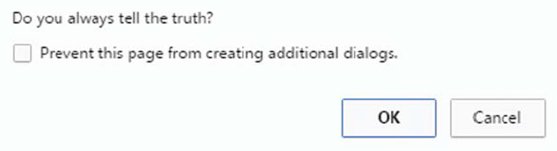
Outline
alert and confirm Methods(continue…)
confirm Method
The confirm method generates a dialog box that displays a specified question. The user is expected to answer yes or no to the question (by clicking OK or Cancel). Here’s an example dialog generated by a confirm method call:
Here’s the syntax for a confirm method call:
confirm(question);
What follows is an example confirm method call that uses this syntax and produces the dialog shown previously:
confirm("Do you always tell the truth?");
In response to the dialog box’s question, if the user clicks OK, then the confirm method returns true. Otherwise, if the user clicks Cancel or clicks the close-out X button, the confirm method returns false.

Slide 6
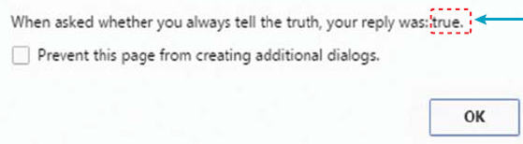
Outline
alert and confirm Methods(continue…)
confirm Method (continue…)
The Lie Detector web page, whose source code appears in example 1., uses the confirm method’s return value to display a message indicating the user’s self-proclaimed level of truthfulness. The web page uses the alert method to display the message, and here’s what the message looks like after the user clicks the OK button:
Note the word “true” at the end of the message. That’s the value returned from the confirm method call after the user clicks the OK button. Study the askAboutLying function in example 1.
Note how the confirm method call appears at the right side of an assignment statement with the reply variable at the left. That means the value returned by the askAboutLying function (either true or false) gets assigned into the reply variable. Note how the next statement, an alert method call, concatenates the reply variable’s value at the end of the alert message.
From the confirm method call.

Slide 7
Outline
alert and confirm Methods(continue…)
confirm Method (continue…)
Example 1.
<!DOCTYPE html>
<html lang="en">
<head>
<meta charset="utf-8">
<meta name="author" content="AAA">
<title>Lie Detector Test</title>
<script>
function askAboutLying() {
var reply; // user's reply
reply = confirm("Do you always tell the truth?");
alert("When asked whether you always tell" +
" the truth, your reply was: " + reply + ".");
} // end askAboutLying
</script>
</head>
<body onload="askAboutLying();">
<h1>Lie Detector Test</h1>
</body>
</html>
How to split a string.

Slide 8
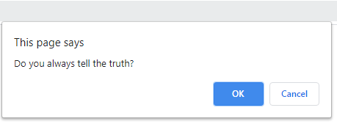
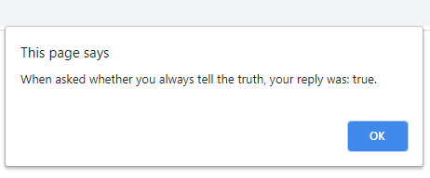
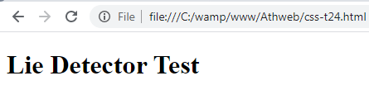
Outline
alert and confirm Methods(continue…)
confirm Method (continue…)
Example 1. (continue…)
Output:
Think about the situation where the alert message displays “your reply was false.” Describe the type of person who would generate that output—someone who always tells truth, someone who always lies, or some other type of person?
Note how it spans two lines. It would have been legal to enter the entire method call statement on one line, but if someone printed the code, line wrap would occur. Line wrap is ugly and leads to code that is harder to understand.
To avoid line wrap, you should press enter at an appropriate breaking point and on the next line, indent past the starting point of the prior line.
That’s what we do for the alert method call, but the breaking point is in the middle of a string, and that requires a little extra work. To break/split a string, terminate the first part of the string with a closing quote, insert a concatenation operator, +, and start next line’s continuation string with an opening quote.

Slide 9
Outline
if Statement: if by itself
In previous example, If the user clicks OK (for yes), then you’ll do one thing, or if the user clicks Cancel (for no), then you’ll do something else. The easiest way to implement that logic is with an if statement.
Syntax
Here’s an if statement that checks a person’s age and displays a message of joy if age is greater than 16:
if (age > 16) {
msg = document.getElementById("message");
msg.innerHTML = "You can now drive without parental supervision. Road trip!";
}
Note how this example fits the syntax shown at the left of figure 1., The syntax requires you to have a condition after the word if. The condition is a question, and it must be surrounded by parentheses. To form a question, you can use the > (greater than) symbol as shown in this example or other comparison operators.
In figure 1., syntax at the left, note the braces ({ }) that surround the statements that follow the condition. In JavaScript (and other programming languages as well), braces are used to group statements together that are logically inside something else.
condition

Slide 10
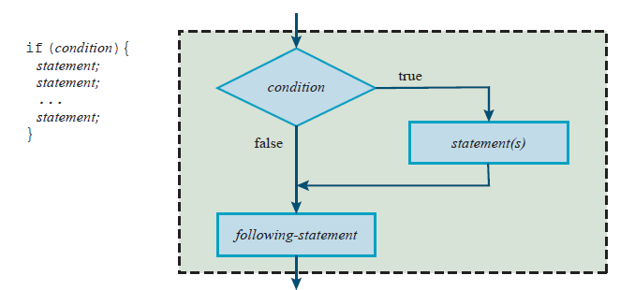
Outline
if Statement: if by itself (continue…)
Syntax (continue…)
The formal term for zero or more statements surrounded by braces is a block statement. A block statement can be used anywhere a standard statement can be used.
Semantics
The semantics of a statement is a description of how the statement works. The diagram at the right side of Figure 1., illustrates the semantics of the if statement by showing what happens for different values of the if statement’s condition. The diagram is a flowchart. A flowchart is a pictorial representation of the logic flow of a computer program.
Figure1., Syntax and semantics for the “if by itself” form of the if statement

Slide 11
Outline
if Statement: if by itself (continue…)
The Game Web Page
We examine a Armor web page with an if statement where the condition again evaluates to true or false, but this time, it might not be as obvious that the condition evaluates to true or false. This time, we use the confirm method call for the if statement’s condition.
Take a look at the Armor Game web page in Example 2. When the user clicks the button, the browser asks whether the user wants to follow the link to the party reservation web page. If the user clicks OK, the browser redirects the user to another web page, to implement that functionality, we use an if statement.
In particular, note the partyOn function’s if statement. As you can see, the condition is a confirm method call, confirm("Can you handle the excitement?").
Remember that the condition needs to evaluate to true or false. Because the confirm method returns a value of true or false, you can think of the confirm method call being physically replaced by a true or false value.
So everything works as expected—if the user clicks OK on the confirm dialog, true is returned, the if condition is true, and the browser executes the statement inside the braces. That statement is a window.location.assign method call, which causes the browser to load web page specified by method call’s URL-value argument.

Slide 12
Outline
if Statement: if by itself (continue…)
The Game Web Page (continue…)
Example 2.
<!DOCTYPE html>
<html lang="en">
<head>
<meta charset="utf-8">
<meta name="author" content="AAA">
<title>Armor Games</title>
<style>
body {background-color: rgb(205, 250, 255);}
</style>
<script>
// Direct the user to the armor game web page.
function partyOn() {
if (confirm("Can you handle the excitement?")) {
window.location.assign( "https://armorgames.com");
}
} // end partyOn
</script>
</head>
<body>
<h1> Armor Games </h1>
<p>
Join Armor Games there wild and crazy of computer fun!
</p>

Slide 13
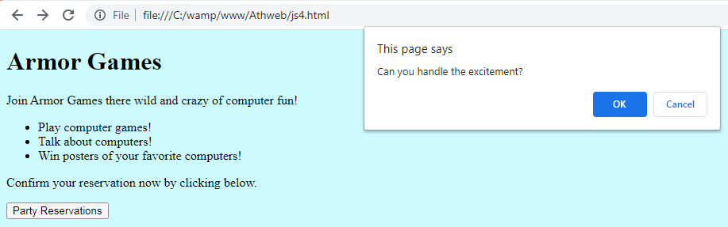
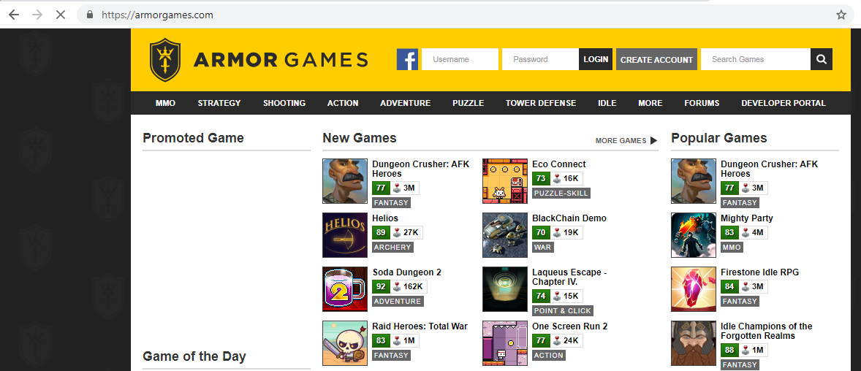
Outline
if Statement: if by itself (continue…)
The Game Web Page (continue…)
Example 2. (continue…)
<ul>
<li>Play computer games!</li>
<li>Talk about computers!</li>
<li>Win posters of your favorite computers!</li>
</ul>
<p>Confirm your reservation now by clicking below.</p>
<input type="button" value="Party Reservations" onclick="partyOn();">
</body>
</html>
Output:

Slide 14
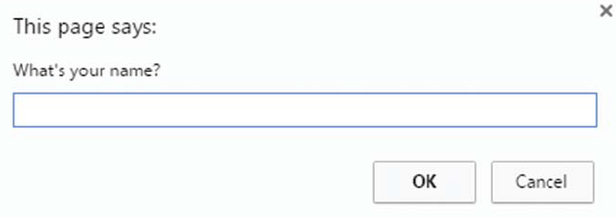
Outline
prompt Method
The prompt method generates a dialog box that displays a specified question. The user is expected to answer the question by entering a value in a text control and then clicking OK. Or, the user may click Cancel to avoid answering the question. Here’s an example dialog generated by a prompt method call:
Here’s the syntax for a prompt method call:
prompt(prompt-message, "")
What follows is an example prompt method call that uses this syntax and produces the dialog shown previously:
prompt("What's your name?", "");
The first argument provides the dialog box’s prompt. The second argument (the two-quoteswith-nothing-in-between thing) specifies the initial value that appears in the prompt box. For example, this would cause zeros to appear in the prompt box:
prompt("What's your student ID?", "0000000");

Slide 15
Outline
prompt Method (continue…)
Normally, you’ll want to display an empty initial value, and to do that, you specify the empty string ("") for the second argument.
The W3C defines the prompt method with two parameters, so you should always include two arguments. However, and not surprisingly, browsers are lenient and they allow one argument. If you omit the second parameter, the Internet Explorer browser displays “undefined” as the initial value (ugly!), whereas Chrome and Firefox display nothing.
If a user sees a prompt dialog box and clicks Cancel or the close-out X button, the prompt method returns the value null, which is a JavaScript keyword that indicates the absence of a user entry.
The Game Web Page Revisited
More specifically, your task is to edit the partyOn function so it does this:
Prompt the user for his/her name.
If the user clicks Cancel, do nothing. Otherwise, display two dialogs with these messages:
The next pop-up will be your party reservation. Print it.
Admit one to the Armor Games: user’s-name.
The first step is to prompt the user for his/her name, we use the prompt method for that. As a web programmer, we’ll want to do something with prompt method’s returned value that means we’ll normally want to embed the method call within an assignment statement or an if statement’s condition.

Slide 16
Outline
prompt Method (continue…)
The Game Web Page Revisited
For the improved Armor games web page, we’ll need to save the user’s input in a variable, so you can display the user’s name on the party reservation pass. To save the user’s input, you need an assignment statement, like this:
name = prompt("What's your name?", "");
Then we need to check the user’s input using the name variable and an if statement, like this:
if (name != null) {
Remember that null is what’s returned by the prompt method when the user clicks the prompt dialog box’s Cancel button, and the user’s string input is returned when the user clicks the OK button.
If condition checks for the user clicking the OK button. Inside the if statement, we need two alert method calls that (1) inform the user about the upcoming party reservation pass, and (2) display the party reservation pass.
Dialog Boxes—Use Them Sparingly
The “improved” armor Game web page uses a prompt dialog box and two alert dialog boxes. That’s probably a bit much. JavaScript’s alert, confirm, and prompt methods are OK when used in small doses, but they can be annoying if used too much because their dialog boxes block users from interacting with anything else.
Another problem with the three dialog box methods is that users will sometimes configure their browsers to disable pop-up windows (including the pop-ups generated by alert, confirm, and prompt).

Slide 17
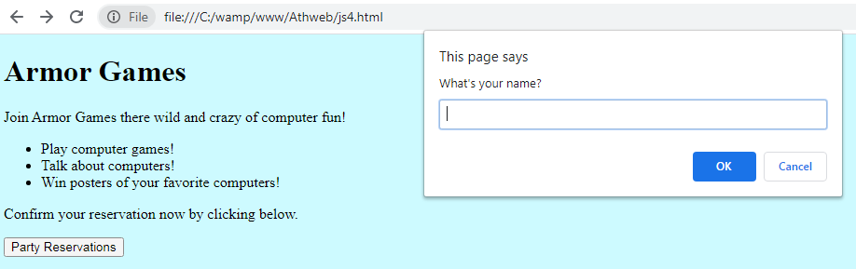
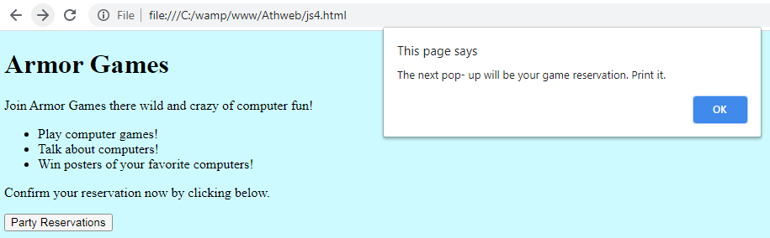
Outline
prompt Method (continue…)
The Game Web Page Revisited
We can see in the following fragment of code the script container for improved Armor Game web page
<script>
// Print a party reservation pa ss.
function partyOn() {
var name; // user's name
name = prompt("What's your name?", "");
if (name != null) {
alert("The next pop- up will be your party" + " reservation. Print it. ");
alert("Admit one to the Armor Games: " + name);
}
} // end partyOn
</script>
Out put :

Slide 18
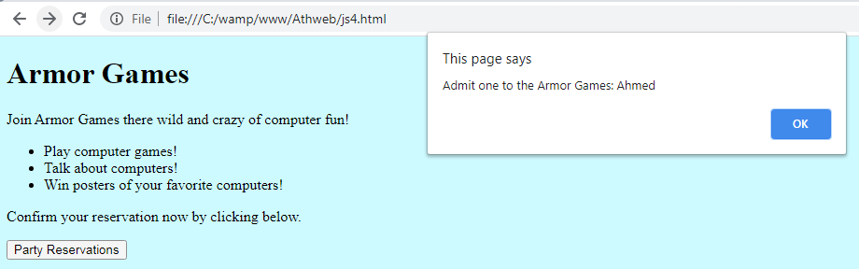
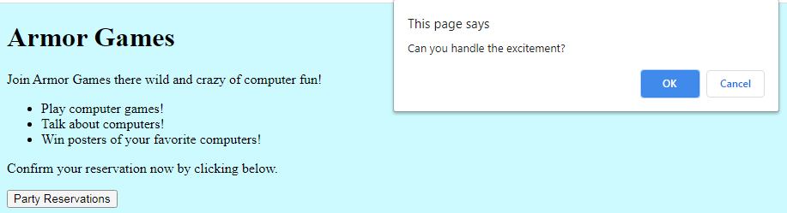
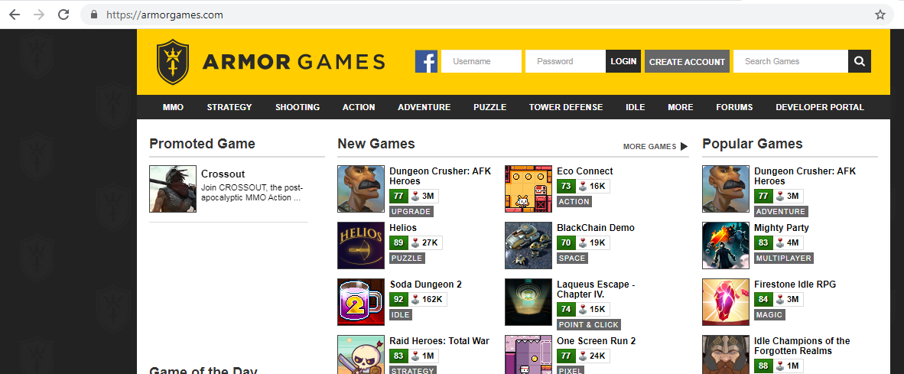
Outline
prompt Method (continue…)
The Game Web Page Revisited
Output: (continue…)
if Statement: else and else if Clauses
We were introduced to the simplest form of the if statement—when the if clause is by it self. What if you want to do one thing from among a list of three or more options? We describe additional forms of the if statement that take care of those situations.
Figure 2., shows the syntax and semantics for the form of the if statement that takes care of the situation where you want to do one thing or something else. It uses same if clause at top that you’ve seen before, but it adds an else clause.

Slide 19
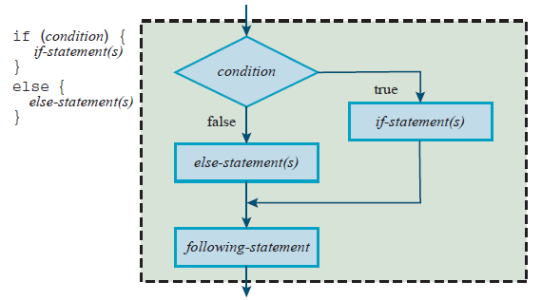
if Statement: else and else if Clauses
(continue…)
Outline
Figure 2., shows the syntax and semantics for the form of the if statement that takes care of the situation where you want to do one thing or something else. It uses same if clause at top that you’ve seen before, but it adds an else clause.
In Figure 3., note the flowchart’s flow of control as indicated by the arrows. After one condition is found to be true, all the other conditions are skipped, and control flows down to the statement below the entire if statement. That means that the JavaScript engine executes only one of the block statements—the one with the condition that’s true. If all the conditions are false and there’s no “else” block, the JavaScript engine executes none of the block statements.
Figure2., Syntax and semantics for the “if, else” form of the if statement

Slide 20
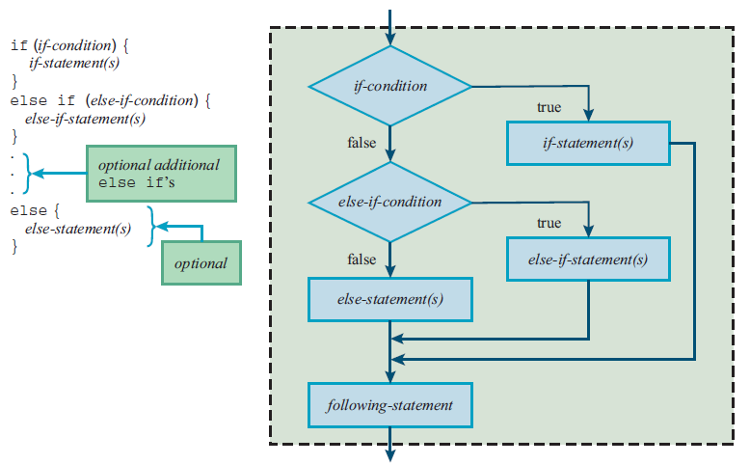
if Statement: else and else if Clauses
(continue…)
Outline
Here’s a summary of the different forms:
“if by itself ”—use when you want to do one thing or nothing.
“if, else”—use when you want to do one thing or another thing.
“if, else if ”—use when there are three or more possibilities.
Strings
We’ll learn about some of the functionality that JavaScript provides to make working with strings easier. That added functionality is particularly important because strings are used so often for processing user input.
Figure 3., Syntax and semantics for the “if, else if, else” form of the if statement

Slide 21
Strings (continue…)
Outline
Comparison Operators
In the improved Armor Game web page, remember the following prompt for the user’s name and the if statement that verifies that the user entered something?
var name; // user's name
name = prompt("What's your name?");
if (name != null) {
...
This if statement condition uses the inequality operator, !=, to check whether the name variable’s value is not equal to the null value. As an alternative, we could have used the equality operator, ==, to check whether the name variable’s value is equal to the null value. Here’s what that looks like:
if (name == null) {
Remember that the prompt method returns null if the user clicks the Cancel button. If you want to see if the user clicks the OK button with nothing in the input box, you can compare the name variable to the empty string, like this:
if (name == "") {
When testing for equality, you need to use two equals signs, not one. The single equals sign is for the assignment operator. Remember: When testing for equality, use ==, not =.

Slide 22
Strings (continue…)
Outline
In comparing two strings, all the string comparison operators (<, >, <=, >=, ==, !=) use lexicographical ordering. That means the computer compares the characters in the two strings one at a time until it reaches two characters that are different.
Then it uses alphabetical order for those individual characters to determine the ordering. Thus, because the third-letter “i” in “amino acid” comes after the third-letter “a” in “amanuensis” in the alphabet, the expression "amino acid" > "amanuensis" evaluates to true and the expression "amino acid" < "amanuensis" evaluates to false.
If two strings are compared such that the first string matches the second string’s left side and the second string has additional characters at the right, then the first string comes first in the dictionary. For example, "malaprop" < "malapropism" evaluates to true.
String Concatenation
For example, suppose you have a variable named consumable that holds the value “water” and you want to update it by concatenating “melon” at its right. Here’s how you can do that:
var consumable;
consumable = "water";
consumable += "melon";
After this code executes, the consumable variable holds “watermelon”.

Slide 23
Strings (continue…)
Outline
Escape Sequence Characters and String Continuation with \
In forming a string, you’ll sometimes want to use characters that are difficult to represent. For example, let’s try to store the following exchange between my daughter Jordan (as a toddler) and Jordan’s mother:
"Mommy, hurry up and get dressed – go faster than a horse."
"That's pretty fast, Jordan."
"OK, then go faster than a baby hippopotamus." No response.
"OK, then go faster than a wall. You should be able to beat a wall.“
Most of this code is easy to store—just use the letters and punctuation as is. Note the quote mark (") before “Mommy” and the quote mark after “horse.” Storing those quote marks and the other quote marks is a bit of a challenge. Storing the text as four separate lines is also a bit of a challenge. Here’s a first-cut attempt at storing the first two lines:
var exchange;
exchange = ""Mommy, hurry up and get dressed – go faster than a horse."";
exchange += ""That's pretty fast, Jordan."";
The JavaScript engine interprets ""Mommy as a completed string ("") followed by a variable named Mommy. That’s not right. So, what’s the solution? To nest a string inside a string, you can use single quotes for the inner string and double quotes for the outer string. This second-cut attempt does that:
var exchange;
exchange = " 'Mommy, hurry up and get dressed – go faster than a horse.' ";
exchange += " ' That's pretty fast, Jordan. ' ";

Slide 24
Strings (continue…)
Outline
Escape Sequence Characters and String Continuation with \ (continue…)
With single quotes nested inside the double quotes, if there was an attempt to display exchange’s content, the single quotes would display. Displaying single quotes rather than double quotes might bother some users, but that’s not a big problem.
The apostrophe in " That's " acts as a closing quote for the preceding single quote. And that causes the single quote after " Jordan " to be orphaned. Bottom line—the code doesn’t work. There are several solutions. One solution is to replace the apostrophe in " That's " with the special character \', like this:
exchange += "'That \' s pretty fast, Jordan.'";
JavaScript uses the backslash notation for special characters like the single quote. Those characters are called escape sequence characters because the backslash “escapes” subsequent character (the ' in this case) from its normal meaning. Single quote character, its normal meaning is start or end of a string.
By using the backslash, single quote is just a normal character that’s displayed, so it does not interfere with opening single quote that appears at its left.
For a table of the escape sequences that are useful for web pages, see Figure 4., In addition to the single quote escape sequence, the table shows a double quote escape sequence.
The double quote escape sequence works like its single quote counterpart. When you use \", the double quote is just a normal character that’s displayed, and it does not serve as the start or end of a string.

Slide 25
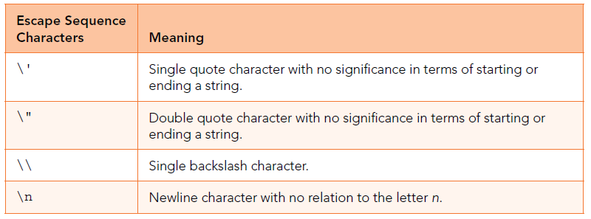
Strings (continue…)
Outline
Escape Sequence Characters and String Continuation with \ (continue…)
You think of how you might use double quote escape sequences to fix the original errant exchange += statement? The solution is to replace the single quotes that surround string with double quote escape sequences, like this:
exchange += " \" That's pretty fast, Jordan.\"";
Suppose a programmer attempts to store a backslash by using a single backslash, like this:
var musicFolder;
musicFolder = "C:\Users\John\Music";
When the JavaScript engine sees a backslash, it interprets the backslash as the start of an escape sequence. When the symbol after the backslash isn’t one of the symbols indicative of a special character, the JavaScript engine simply replaces the escape sequence with the symbol after the backslash.
Figure 4., JavaScript escape sequence characters that are helpful for web pages

Slide 26
Strings (continue…)
Outline
Escape Sequence Characters and String Continuation with \ (continue…)
So in the preceding code fragment, the \U gets replaced with U, the \J gets replaced with J, the \M gets replaced with M, and the musicFolder variable ends up with an incorrect path because all \’s get stripped out. Here’s corrected assignment statement:
musicFolder = "C:\\Users\\John\\Music";
Arithmetic Operators
Addition, Subtraction, Multiplication, and Division
JavaScript uses +, -, and * for addition, subtraction, and multiplication, respectively. They work the same as the addition, subtraction, and multiplication operators you learned in elementary school. The multiplication operator uses the asterisk (*) and not a cross (×) or a dot (∙) as in mathematics books, but other than that, there are no differences, so let’s move on.
JavaScript supports two forms of division. For regular division, use the division operator, which is implemented with the / symbol. For division where you want to find the remainder, use the remainder operator, which is implemented with the % symbol. The following examples use the division and the remainder operators, respectively:
13 / 5 ⇒ 2.6
13 % 5 ⇒ 3

Slide 27
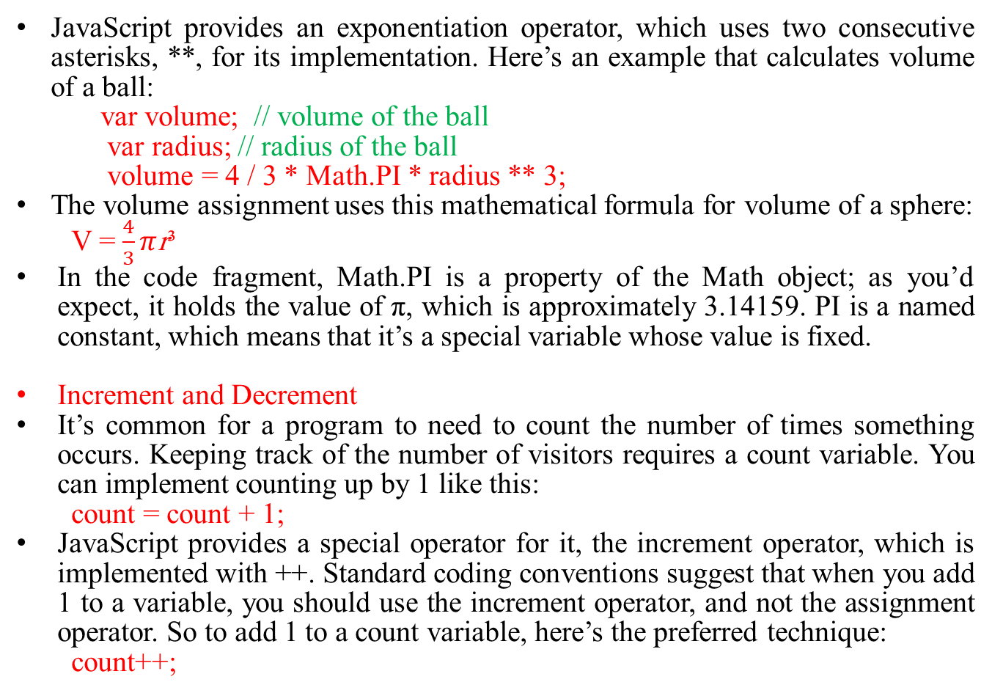
Arithmetic Operators (continue…)
Outline
JavaScript provides an exponentiation operator, which uses two consecutive asterisks, **, for its implementation. Here’s an example that calculates volume of a ball:
var volume; // volume of the ball
var radius; // radius of the ball
volume = 4 / 3 * Math.PI * radius ** 3;
The volume assignment uses this mathematical formula for volume of a sphere:
V = $\frac{4}{3}π$r³
In the code fragment, Math.PI is a property of the Math object; as you’d expect, it holds the value of π, which is approximately 3.14159. PI is a named constant, which means that it’s a special variable whose value is fixed.
Increment and Decrement
It’s common for a program to need to count the number of times something occurs. Keeping track of the number of visitors requires a count variable. You can implement counting up by 1 like this:
count = count + 1;
JavaScript provides a special operator for it, the increment operator, which is implemented with ++. Standard coding conventions suggest that when you add 1 to a variable, you should use the increment operator, and not the assignment operator. So to add 1 to a count variable, here’s the preferred technique:
count++;

Slide 28
Arithmetic Operators (continue…)
Outline
Increment and Decrement (continue…)
Counting down is also a common task, so JavaScript provides a special operator for it, the decrement operator, which is implemented with --. Suppose you keep track of the number of remaining coupons with a variable named remainingCoupons. After using a coupon, you should implement the decrementation process like this:
remainingCoupons--;
Standard coding conventions suggest that you always use the decrement operator to decrement a variable by 1 (as shown), but you should be aware of this alternative code:
remainingCoupons = remainingCoupons – 1;
This code works, but you should avoid using it.
Compound Assignment Operators
We present operators that combine those two functions—assignment and arithmetic. Here’s how you can update x by adding 99.9 to it:
x = x + 99.9;
And here’s the alternative way to do the same thing:
x += 99.9;
The += thing is the addition assignment operator. Standard coding conventions suggest that you use the addition assignment operator to add a value to a variable. The -=, *=, /=, %=, and **= operators parallel the += operator, and they are collectively referred to as compound assignment operators.

Slide 29
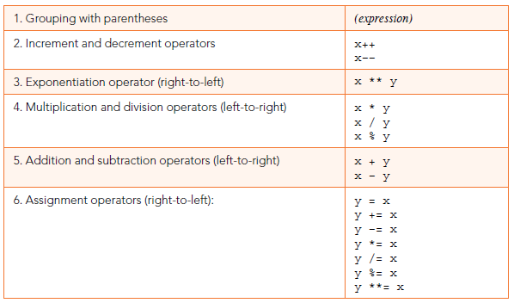
Arithmetic Operators (continue…)
Outline
Increment and Decrement (continue…)
We won’t bore you with detailed explanations, because they all work same as addition assignment operator, but make sure you understand these examples:
x -= 10; ≡ x = x - 10;
x *= num; ≡ x = x * num;
x /= 5.5; ≡ x = x / 5.5;
x %= 3; ≡ x = x % 3;
x **= 1.5; ≡ x = x ** 1.5;
x *= num - 2; ≡ x = x * (num - 2);
The examples show compound assignment operator statements on the left and their equivalent long-form statements on right. The ≡ symbol means “is equivalent to.”
Figure5., Abbreviated operator precedence table

Slide 30
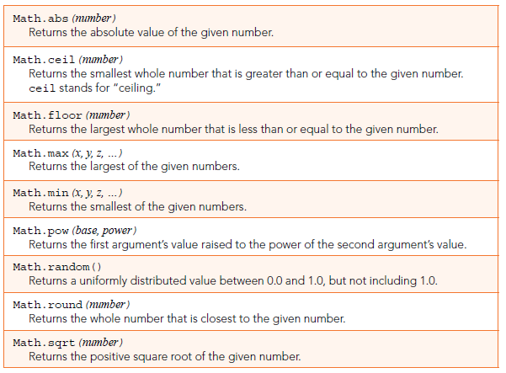
Math Object Methods
Outline
JavaScript has more than 30 methods that perform mathematical operations.
We don’t want to overwhelm you with all of them. We present the ones that tend to be used most often.
In figure 6., They’re all pretty straightforward, but one thing you should be aware of is that if you use a variable for one of the arguments, the method calculates a value as described in the figure and returns that calculated value, but the argument variable’s value doesn’t change. So If you want to change the value of a variable x so it holds the absolute value of its original value, this won’t work:
Math.abs(x);
Instead, you need to do this:
x = Math.abs(x);
Figure 6., Some of the more popular Math methods—their headings and descriptions

Slide 31
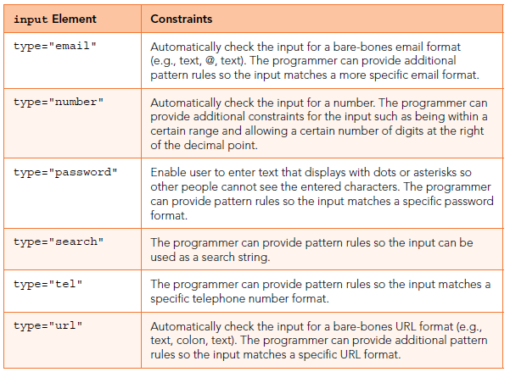
Constraint Validation for Form Controls
Outline
In Figure 7., there are six such controls. They all display boxes that look like text controls, but they have the ability to check the user’s input to make sure it fits within specific constraints.
The following code displays a one-line plain text edit control that checks the user’s input to make sure it uses the format “firstname.lastname@uoitc.edu”:
<input type="email" title="firstname.lastname@uoitc.edu"
pattern="[A-Za-z0-9]+\.[A-Za-z0-9]+@uoitc.edu">
The pattern attribute’s value is a regular expression that specifies one or more alphabetic or numeric characters, a dot, one or more alphabetic or numeric characters, the @ sign, and then @uoitc.edu.
Figure 7., One-line plain text edit controls that are customized to handle specific types of input

Slide 32
Comparison Operators and Logical
Operators
Outline
Comparison Operators
As you know, an if statement’s heading includes a condition with parentheses around the condition, like this:
if (condition) {
...
Usually (but not always), the condition performs some type of comparison, and the comparison uses a comparison operator. Here are JavaScript’s comparison operators:
<, >, <=, >=, ==, !=, ===, !===
Each comparison operator compares two operands and returns either true or false, depending on the values of those operands. The <, >, <=, and >= operators are collectively referred to as JavaScript’s relational operators.
The ==, !=, ===, and !== operators are collectively referred to as JavaScript’s equality operators.
Logical Operators
An if statement will sometimes need a condition that involves more than one test. The && (pronounced “and”) and || (pronounced “or”) operators enable you to tie multiple tests together to form a nontrivial if condition.
For example, suppose you’re designing a web page that checks whether a user-entered vehicle speed is legal in the United Kingdom. Different types of roads have different minimum and maximum speeds.

Slide 33
Comparison Operators and Logical
Operators (continue…)
Outline
Logical Operators (continue…)
For a dual carriageways road, the minimum speed is 40 mph and the maximum speed is 70 mph. If the user enters a speed in a text control and then clicks the Dual Carriageways button, the following code uses the && operator to check that the speed is at least 40 mph and the speed is no greater than 70 mph:
speed = form.elements["speed"].valueAsNumber;
if (speed >= 40 && speed <= 70) {
...
We could have added inner parentheses to make it obvious that the >= and <= operators need to be executed before the && operator:
if ((speed >= 40) && (speed <= 70))
The JavaScript engine automatically executes the >= and <= operators before the && operator. Note the operator precedence table in figure 8., and verify that the comparison operators (including >= and <=) have higher precedence than the logical and operator (&&).
If you have a situation where only one of two conditions needs to be true for the result to be true, then you should use the || operator. For example, suppose you’re designing a medical advice web page for your astrology practice. The following code uses the || operator to check whether a user-entered blood type is A or B:
bloodType = form.elements["bloodType"].value;
sign = form.elements["zodiacSign"].value;
if ((bloodType == "A" || bloodType == "B") && sign == "Taurus") {
alert("You are susceptible to ACL tears." + " Adding myrrh to your incense should help.");
}

Slide 34
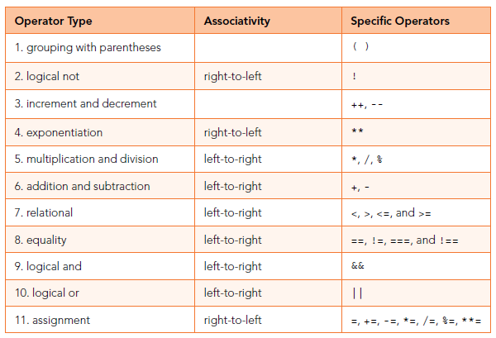
Comparison Operators and Logical
Operators (continue…)
Outline
Logical Operators (continue…)
Note that the bloodType variable appears twice in the if statement’s condition. That’s necessary because you must repeat the variable when both sides of an || condition involve the same variable. Note that we’re using not only the || operator, but also the && operator.
The code works as expected—if the user has A or B blood and the user is a Taurean, then the entire if condition is true. In the preceding code fragment, note the inner parentheses surrounding the || operation. We want the JavaScript engine to execute the || operator before the && operator, and the parentheses force that order of operation.
Figure 8. JavaScript operator precedence table

Slide 35
Comparison Operators and Logical
Operators (continue…)
Outline
Logical Operators (continue…)
The && and || operators are referred to as logical operators because they rely on true and false logic. There’s one more logical operator, the ! (pronounced “not”) operator.
The ! Operator reverses truth or falsity of an expression. So if you have an expression that evaluates to true, and you stick a ! operator in front of it, resulting expression evaluates to false. suppose variable sign contains value “Taurus”. Then following ! operators turn true to false and false to true, respectively:
!(sign == "Taurus") ⇒ false
!(sign == "Virgo") ⇒ true
If you dislike the three fire zodiac signs (Aries, Leo, and Sagittarius) and want to exclude them using an if condition, you can do this:
if (!(sign == "Aries" || sign == "Leo" || sign == "Sagittarius"))
Note that the ! is inside one set of parentheses and outside another set. Both sets of parentheses are required. The outer parentheses are necessary because the compiler requires parentheses around the entire condition.

Slide 36
Outline
Summary
In this lecture we explained the An alert and confirm boxes, the alert box was often used if we want to make sure information comes through to the user. A confirm box was often used if we want the user to verify or accept something.
Also we clarified the usage of if statement, that used when we want to do one thing or nothing.
In this lecture we highlighted the meaning and usage of the prompt() method, that was used to display a dialog with an optional message prompting the user to input some text. It was often used if the user wants to input a value before entering a page.
Also we explained briefly the if Statement: else and else if Clauses. Where the (if , else) used when we want to do one thing or another thing, while (if, else if) used when there were three or more possibilities.
Also we explained the string and we described briefly the comparison operators, string concatenation, and the escape sequence characters and string continuation with \.
This lecture highlighted the kinds of arithmetic operators usage like addition, subtraction, multiplication, and division, as well as increment and decrement operations and compound assignment operators.
Also we clarified the JavaScript math object, that allows us to perform mathematical tasks on numbers.
In this lecture we explained briefly the constraint validation for form controls.
In the last section we explained the comparison operators and logical operators.

Slide 37


THANK YOU

